Slide 1
Digital Image Representation & Processing(1/2)
Lecture-2

Slide 2
To discuss…
Image fundamentals
Image Formation
1-bit & 8 bit image
Color image
Color Lookup Table

Slide 3
Digital Image
Image can be defined as a 2-D function f(x,y), where x and y are spatial coordinates and the amplitude of f at any pair of coordinates (x,y) is called the intensity/gray level of the image at that point
  When the image is gray scale, intensity values represent the range of shades from black to white.
  For a color image the intensity values are represented as a combination of R, G, B
Can be considered as comprising x x y number of elements (picture elements, image elements, pels, pixels), each of which has a location and value.

Slide 4
Image Formation
Pixel values are proportional to the energy/ electromagnetic waves radiated from the source
  It implies this value cannot be negative, ranges from 0 to +ve infinity
Function f(x,y) characterized by components
  Illumination i(x,y), value ranging from 0 to infinity
  Reflectance r(x,y), value ranging from 0 to 1
  f(x,y)= i(x,y) x r(x,y)
f(x,y) lies between L_{min} to L_{max} scaled to [0,L-1], where 0 representing black and L-1 representing white, the intermediate values are the shades of gray from black to white

Slide 5
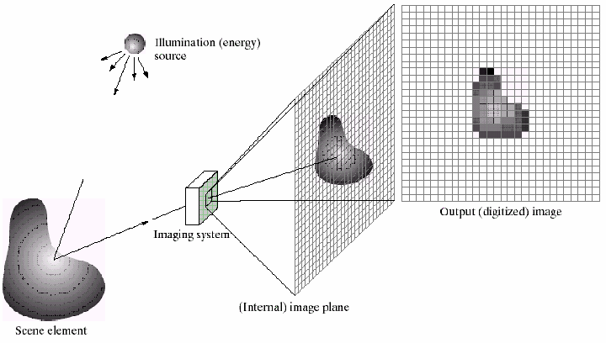
Image Formation [2]

Slide 6

Image Formation [3]

Slide 7
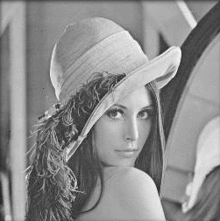

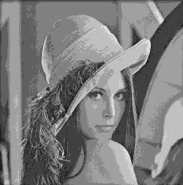
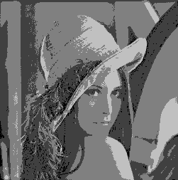
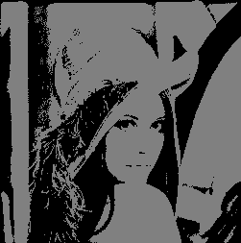
Image Formation [4]
256 gray levels (8bits/pixel) 32 gray levels (5 bits/pixel) 16 gray levels (4 bits/pixel)
8 gray levels (3 bits/pixel) 4 gray levels (2 bits/pixel) 2 gray levels (1 bit/pixel)
11-Jan-07
Multimedia Computing (EA C473)

Slide 8
Image Formation[5]
Output of image sensors are continuous voltage waveform, digitization is necessary for further processing
Digitizing the coordinate positions are called sampling
Digitizing the amplitude values are called quantization
  Number of gray levels will be in an integer power of 2
  L=2^{k} , [0…L-1]
  Number of bits needed to store an image b=M x N
Image is k bit image if it has 2^{k} gray levels
  8 bit image has 256 gray levels
11-Jan-07
Multimedia Computing (EA C473)

Slide 9
1-bit image
Simplest type of image
Each pixel consist of only ON / OFF information
Called 1-bit monochrome (since no color) image
Suitable for simple graphics & text
  JBIG (Joint Bi-level Image experts Group ), A compression standard for binary image

Slide 10

8-bit image
Gray levels between 0 to 255 (black to white)
Image resolution refers the number of pixels in an image. The higher the resolution, the more pixels in the image. Higher resolution allows for more detail and subtle color transitions in an image
Shown is 512x512 byte image

Slide 11
Color image
24- bit color image
  Each pixel is represented by 3 bytes, RGB
  Each R, G, B are in the range 0-255
  256 x 256 x 256 possible colors
  If space is a concern, reasonably accurate color image can be obtained by quantizing the color information
8- bit color image
  Carefully chosen 256 colors represent the image
  We get information can be received from the color histogram

Slide 12
Color image [2]
For 640 x 480 image represented with
  24 bits requires 921.6 kbytes
  8 bit requires 300 kbytes
The 8-bit color image stores only the index of the color, the file header will contain the mapping information.
The table where the color information for all the 256 indices is called color lookup table (LUT)

Slide 13
Color Lookup Table
In the 8 bit index to LUT, 3 bits refer to Red, next 3 bits refer to Blue and the remaining 2 bits for Green
LUT can be generated via
  Clustering
    Clustering slower / complex process
  Dividing RGB space in to equal sized cubes
    Simple process
    No LUT would even be required
    Produce edge artifacts
      slight change in RGB resulting in new code

Slide 14
Color Lookup Table [2]
Median-Cut Algorithm
  Find the smallest box that contains all the colors in the image
  Sort the enclosed colors along the longest dimension of the box
  Split the box into two regions at the median of the sorted list
  Repeat steps 2 & 3 until the original color space has divided in to 256 regions
  For every box, the mean of R,G & B will represent the box
  Based on the Euclidean distance between these representatives, assign every pixel a representative value
The new image generated is called color quantized image

